Slide 1

Zomato eda project
Kiran Kamble

Slide 2
An Overview about Zomato
Zomato has an average of 17.5 million monthly transacting customers for its food delivery business average monthly active food delivery restaurant partners on Zomato's platform have also increased by 8.7% year-on-year, from 208,000 to 226,000.You are working in a data-driven role at Zomato. You have a dataset of customers. As a data professional, you need to analyze the data, perform EDA (Exploratory Data Analysis) and visualization, and answer the following questions:

Slide 3
Scenarios
What type of restaurant do the majority of customers order from?
How many votes has each type of restaurant received from customers?
What are the ratings that the majority of restaurants have received?
Zomato has observed that most couples order most of their food online. What is their average spending on each order?
Which mode (online or offline) has received the maximum rating?
Which type of restaurant received more offline orders, so that Zomato can provide those customers with some good offers?

Slide 4
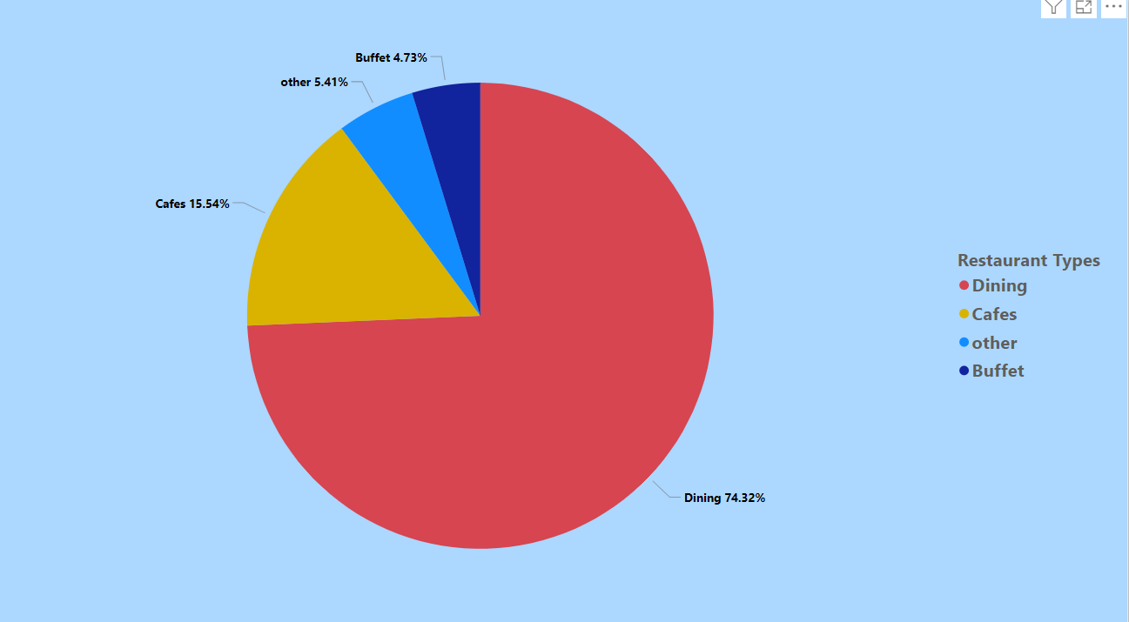
What type of restaurant do the majority of customers order from?

Slide 5
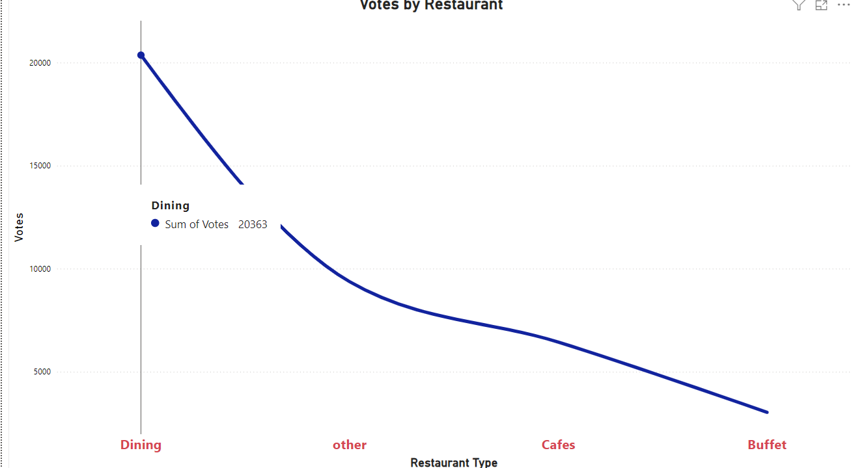
How many votes has each type of restaurant received from customers?

Slide 6
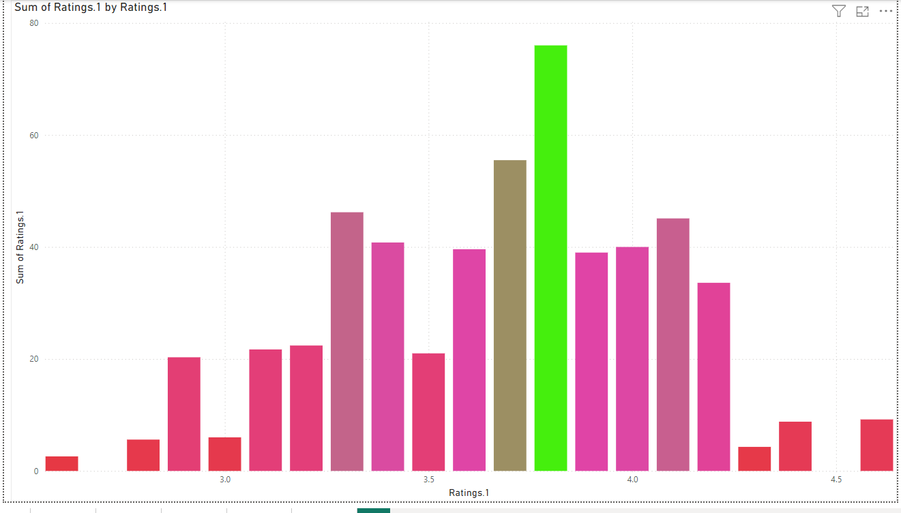
What are the ratings that the majority of restaurants have received?

Slide 7
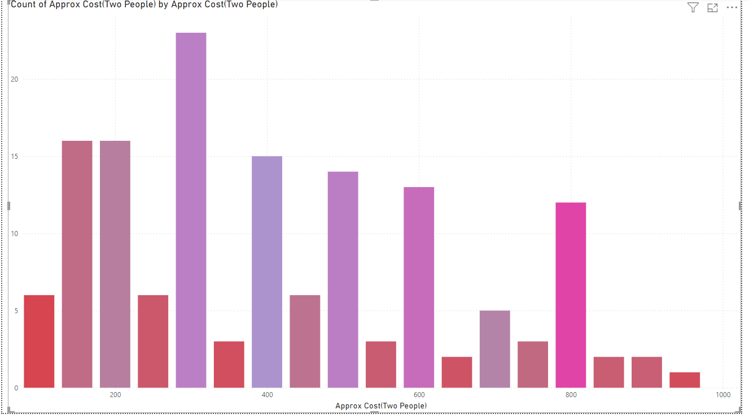
What is the average spending on each order?

Slide 8
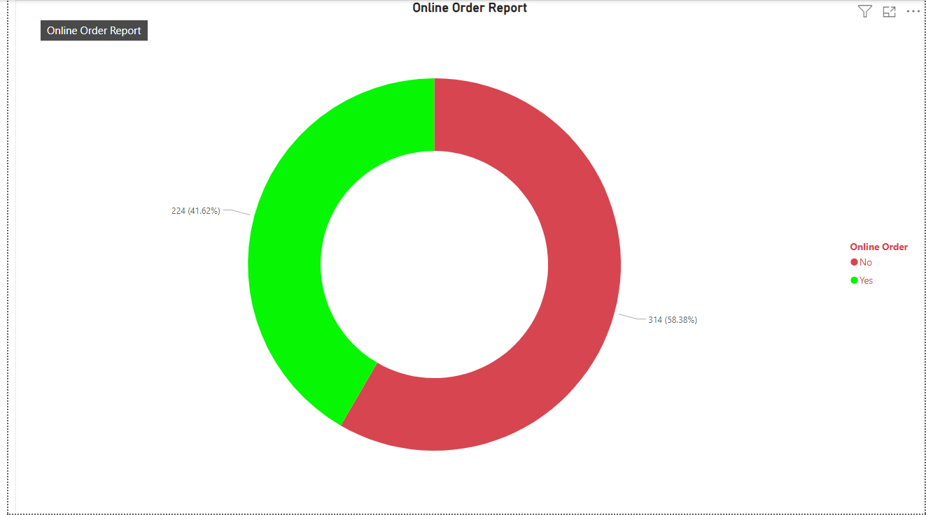
Which mode (online or offline) has received the maximum rating?

Slide 9
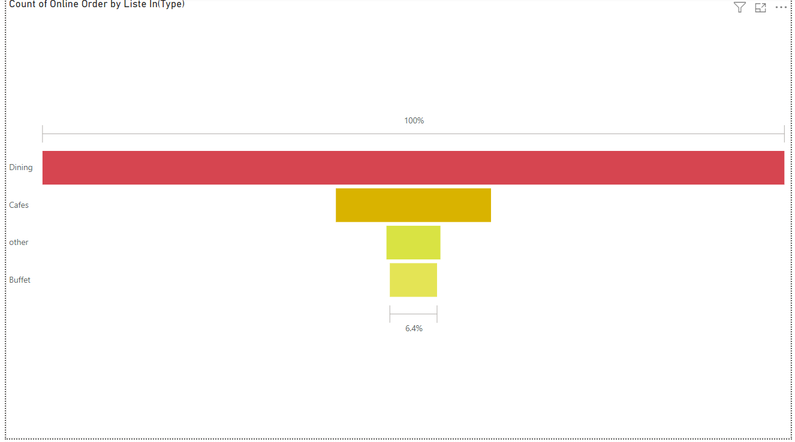
Which type of restaurant received more offline orders, so that Zomato can provide those customers with some good offers?

